Slide 1

Blood-Brain Barrier Drug Prediction
George Iniatis
Notes:
Hello I’m George and my project was about the prediction of drugs and compounds that can penetrate the blood-brain barrier or not. This presentation will be a high-level introduction to the project, leaving detailed technical aspects and decisions out of it.

Slide 2
Why is a prediction system needed?
Manually checking whether a drug or compound can penetrate the blood-brain barrier using laboratory experiments is expensive, time consuming and highly inefficient
A prediction system can test thousands of drugs and compounds in a fast highly efficient manner
A prediction system can lead to a more efficient allocations of time resources
Notes:
Why is a prediction system needed? Manually checking drugs and compounds in laboratories is time consuming, expensive and can only be done one drug at a time, making the whole process extremely inefficient. A prediction system can test thousands of drugs in an efficient fast and cheap manner and can be used effectively as an early screening process leading to a better allocation of time and resources for manual checks by discovering those drugs or compounds that are worth checking in more detail.

Slide 3
Project Objectives
Gather
Gather a new curated data set with as much as possible drugs and compounds with known blood-brain barrier permeability using a variety of methods
Train
Train machine learning models that use the chemical properties of a drug or compound
Evaluate
Evaluate the models using multiple techniques and methods making sure that they are robust and with high predictive performance
Build
Build a rudimentary system that make use of the trained models
Notes:
The project’s objectives. The first step was to gather a large curated dataset of drugs and compounds known to cross into the brain and those that cannot along with some of their chemical properties. Next was the training of machine learning models, their evaluation and finally the creation of a very simple but user friendly system that uses the trained models to make predictions.

Slide 4
Past Solutions
Traditional approaches used hundreds if not thousands of chemical descriptors to train their models leading to high training times
Correlation studies managed to reduce the number to 19 highly important chemical descriptors
A recent novel approach mapped the well recorded side effects and indications of drugs and compounds into subgroups and added them to some of the chemical descriptors
Inspired by these past solutions we aimed to combine these approaches for our solution
Notes:
Past solutions to the problem. The traditional approach was to use hundreds if not thousands of chemical descriptors produced from special not widely available software, to train the various models. These would require high computational power and training times. Correlation studies however managed to reduce the number of chemical descriptors to a much more manageable and highly efficient size that would not only decrease training times but also improve predictive performances.
A more recent approach to solving the problem decided to map the drugs’ side effects and indications, what they are used to treat, into subgroups and combine them with the chemical descriptors. These model achieved high predictive performance and more accurately captured other methods of penetrating the blood-brain barrier that cannot be accurately explained just through the chemical properties of a drug or compound.
Inspired by these solutions we aimed to combine parts of them to produce our own solution to the problem.

Slide 5
Accomplishments
A new curated data set of 2396 drugs and compounds was created using multiple academic papers and medical APIs
Classification and Regression machine learning models were trained using just 6 hydrogen-bonding chemical descriptors
The predictive performance of the classification models was further improved through the addition of side effects and indications to the chemical descriptors
Models were checked for robustness and evaluated using dummy models, holdout tests and multiple metrics
Notes:
The project’s accomplishments. Multiple classification and regression models were trained using subsets of a new curated data set of 2396 publicly available drugs and compounds and 6 hydrogen-bonding chemical descriptors. The classification models were further improved through the addition of the available side effects and indications to the chemical descriptors. Unfortunately this could not be replicated for the case of the regression models due to the available subset size. All models were checked for robustness and evaluated using dummy models as a baseline and holdout test sets, calculating multiple metrics.

Slide 6
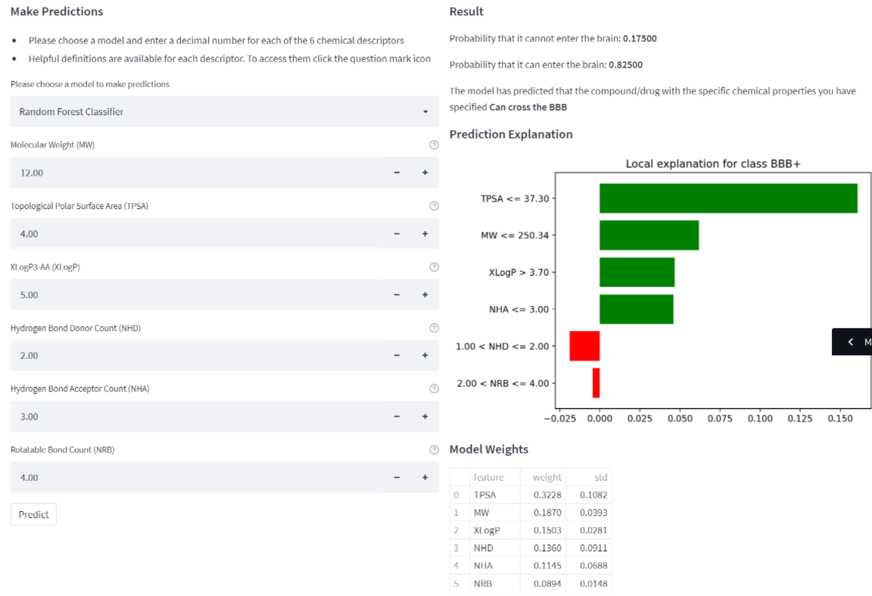
Accomplishments continued
Side effects and indications playing an important role in blood-brain barrier permeability were discovered through feature elimination
A Streamlit web application with a strong emphasis on model interpretability was created to showcase all of our work and to allow users to use the trained models to make predictions
Notes:
We also discovered a list of side effects and indications that appear to play a highly important role in deciding blood-brain barrier permeability, however some of them like the side effects of dry skin or influenza could be argued that they do not seem like the most sensible choices.
Lastly a Streamlit web application was created to present a synopsis of our work and to primarily showcase our models, allowing users to use them to make predictions. A strong emphasis was also placed on model interpretability that can potentially help users understand what led to a specific prediction by a model.
As we can see from the screenshot the model predicts that a drug with these specific chemical properties has an 82.5 percent chance of penetrating the blood brain barrier because it has a topological polar surface area less than 37.3, a molecular weight less than 250.3 and it goes on ad on. These kind of tools can help shine some light in the inner workings of our models without requiring a strong chemical or medical knowledge even though it would definitely be considered a plus.

Slide 7
Best Models
Best Classification Models
Set | Model | Features | Accuracy | Recall | Precision | F1 | MCC
Test Set (69 Compounds) | Random Forest Classifier | Chemical Descriptors | 0.8116 | 0.9250 | 0.7872 | 0.8506 | 0.6145
Test Set (69 Compounds) | Random Forest Classifier | Chemical Descriptors + Side Effects + Indications | 0.8406 | 0.8750 | 0.8537 | 0.8642 | 0.6716
Best Regression Model
Set | Model | Features | Negated MAE | R2 Score
Test Set (81 Compounds) | Support Vector Regression | Chemical Descriptors | -0.3968 | 0.4746
Notes:
Best models. Here are our best classification and regression models produced. As we can see the addition of side effects and indications to the chemical descriptors increased the overall predictive performance of our random forest classifier, even though it suffered from a recall decrease. This was also observed in all but 1 of our classification models, further confirming that the addition of side effects and indications to the chemical descriptors positive impacts our models predictive performances.

Slide 8
Conclusions
Highly predictive machine learning models can be trained using a tiny number of hydrogen-bonding chemical descriptors
The addition of side effects and indications to the chemical descriptors generally improves the predictive performance of the models
Notes:
Conclusion. The project confirmed that highly predictive machine learning models can be trained using a tiny number of hydrogen-bonding chemical descriptors and that these models can further be improved through the addition of side effects and indications to the chemical descriptors of a drug or compound.
The created models can be used efficiently to predict the blood-brain permeability of thousands of already existing or new drugs and compounds. However, these predictions should be taken as guidelines for further research, possibly even experimental trials in order to confirm them, and not as absolutes, as no model can be perfect. Given the important health consequences of a false positive or negative no one should trust a model completely, no matter how accurate it claims to be.

Slide 9
Future Work
The data set could be expanded even more
Professionals with medical or chemical knowledge could potentially point our mislabelled drugs
In-depth error analysis
Deep learning
Notes:
Future work. Even though it could be argued that the project was reasonably successful, a few areas of improvement could be explored further into the future. The data set could be expanded further employing the help of professionals with chemical and medical knowledge that could potentially point out any mislabelled entries, which could then be used to retrain the models or create new ones, even potentially utilising deep learning to produce even better models with greater predictive performances.
The already trained models could be improved by analysing their blind spots, the chemical areas of drugs and compounds that are consistently misclassified or produce a high error value. Some preliminary error analysis of the predictions made by our models found what appear to be groupings, suggesting that there is some pattern that could be looked at in more detail. These systematic weaknesses could be negated by further exploring the errors, but some in-depth chemical knowledge would be required, which we did not have during the project’s life-cycle.
Thank you for your attention.

